Slide 1
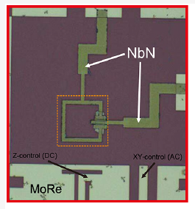

Flux Tunable Superconducting Quantum Circuit Based on Weyl Semimetal MoTe2 (Part I)
By Kuei-Lin Chiu et al.
Presented by Thomas Kuo(Part I) ; 謝凱閔(PartII)
National Sun Yat-Sen University (中山大學)
12/29/2020

Slide 2
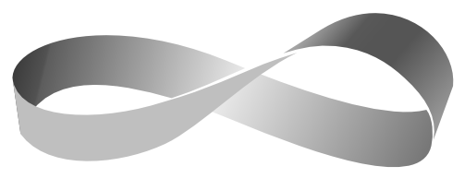
Outline
Abstract
Introduction
Brief history of Topological Physics
Weyl semimetals and its properties
Candidacy as a Quantum computation device
Device Fabrication and Measurement Setup
Device layouts and Measurement setup
Stages of Fabrication
Device Characterization and Results
Power dependence measurements
Coupling strength estimations

Slide 3
Abstract
Demonstrates a JJ made of MoTe2 and a flux-tunable transmon like circuit based on Weyl semimetals (WSM)
Weyl semimetals have drawn considerable attention for their exotic topological properties in many research fields.
When in combination with s-wave superconductors, WSMs form junctions mimicking the behavior of Majorana bound states.
Present a transmon-like SQUID made of Weyl semimetal Td−MoTe2 and superconducting leads of niobium nitride (NbN)
At high power reveals the existence of the constituting Josephson junctions
The loop geometry of the circuit allows the resonant frequency of the readout cavity to be tuned by the magnetic flux.
Notes:
Topological properties: topologically protected, electron effective mass = 0 (high mobility), topological phase conduction (Insulator/conductor), non-zero spin current
Transition metal dichalcogenide (TMD) 過渡金屬二硫屬化合物, 二維維度 及 具有材料特性: 高電子流動性(mobility)、低漏電流(leakage current)、高可撓性(flexibility)
2. When combined with s-wave superconductors, the supercurrent can be carried by their topological surface channels

Slide 4
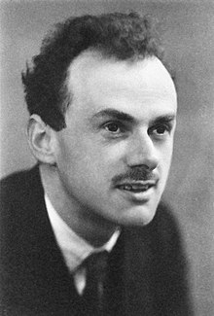

Introduction – Dirac equations
In 1928, Dirac equation (special relativity + QM)
Solution used 4x4 complex matrices (gamma matrices) and a four-component wave function.
Leads to new concept of spin, predicted existence of antimatter, QFT
Describes relativistic electrons
Leads to topological phenomena (zero modes and anomalies in QFT)
Paul A. M. Dirac, English Physicist

Slide 5

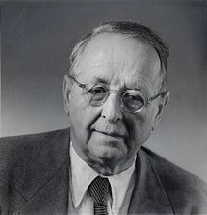
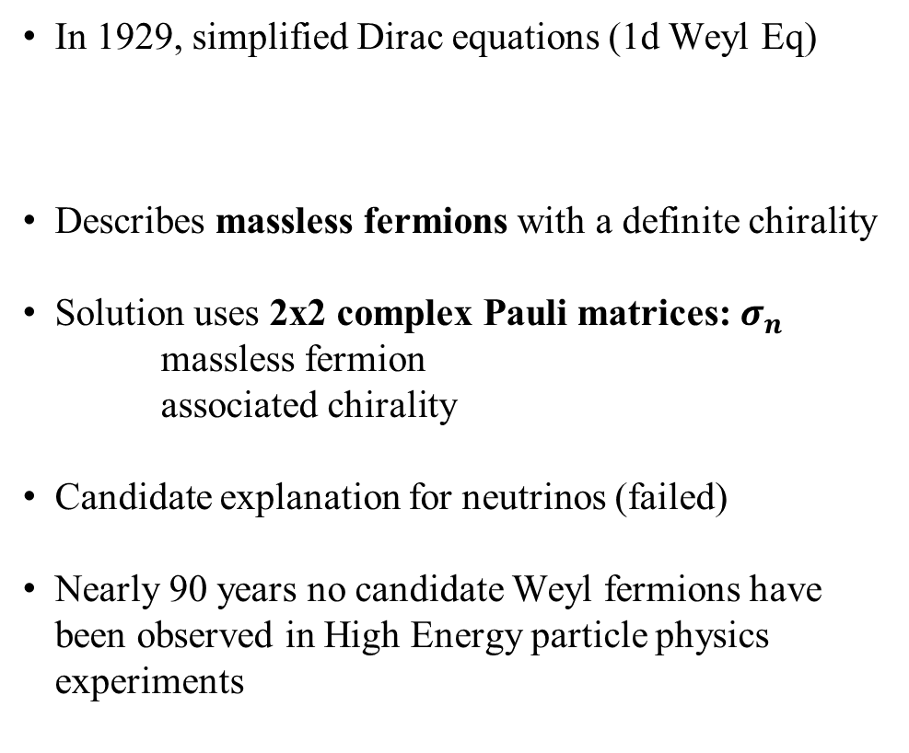
In 1929, simplified Dirac equations (1d Weyl Eq)
Describes massless fermions with a definite chirality
Solution uses 2x2 complex Pauli matrices: $σ_{n}$
massless fermion
associated chirality
Candidate explanation for neutrinos (failed)
Nearly 90 years no candidate Weyl fermions have been observed in High Energy particle physics experiments
Hermann Klaus Hugo Weyl, German mathematician

Slide 6
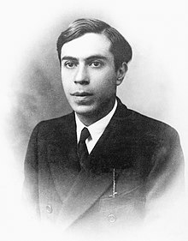
In 1937, Majorana found a modification using real numbers that described a neutral particle that was its own antiparticle
Majorana bound states
Ettore Majorana, Italian Physicist

Slide 7
In condensed matter physics…
Dirac equation appears in certain instances of CM physics
Graphene’s linear momentum dispersion relation is captured by the massless 2D Dirac equation.
Recent work has found evidence for Majorana bound states in 1D superconducting wires (Mourik et al., 2012; Elliott and Franz, 2015)
New properties that exist only in a CM context emerge (ex: Fermi arc surface states)
New fermion types with no counterpart in high-energy physics can emerge (e.g., type-II Weyl, spin-1 Weyl, double Dirac, etc.) (Soluyanov et al., 2015; Xu, Zhang, and Zhang, 2015; Bradlyn et al., 2016; Wieder et al., 2016)
Notes:
Herring (1937) found accidental twofold degeneracies of bands even in the absence of any symmetry in a three-dimensional solid.
The dispersion in the vicinity of these band touching points is generically linear and resembles the Weyl equation!
Exhibit many of Weyl fermion physical properties (e.g., chiral anomaly)
These band touchings of Herring were named “Weyl Nodes”
Topological consequences of Weyl nodes began to gain massive attention:
Realization that Berry curvature plays a key role in determining the Hall effect
Realization of Weyl nodes in superfluids (He3) (Volovik 1987) and superconductors
Prediction and discovery of Topological Insulators (TIs) in 2,3 dimensions
surfaces of TIs in 3D feature a gapless Dirac dispersion (analogous to 2D semimetal graphene with different number of nodal points)

Slide 8
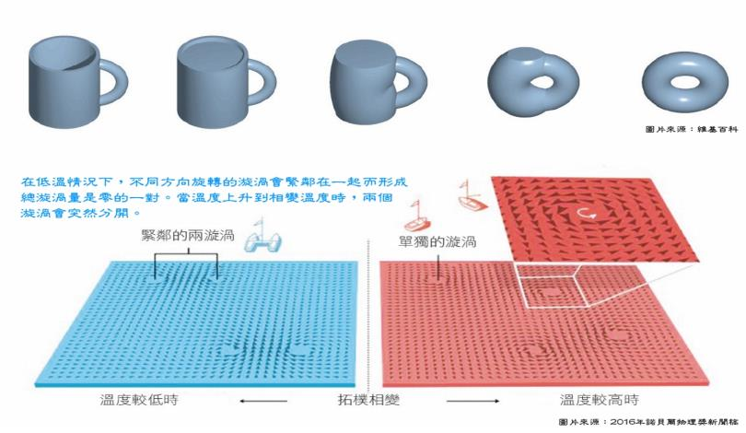
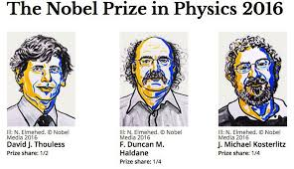
Topological Physics
David J. Thouless,
F. Duncan M. Haldane,
J. Michael Kosterlitz
Notes:
在拓樸學上，球、碗這些沒有洞的幾何形狀屬於同一類，因為它們彼此可以藉由連續變化而轉變成對方，但馬克杯和甜甜圈這些有一個洞的幾何形狀則屬於另一類。
簡單來說，這類幾何圖形中洞的數目並不會受到連續的形變而改變，而這個不變的量就稱為拓樸性質，另稱拓樸不變量，在拓樸學上，這些「洞」則稱為「虧格(genus)」。
另外，從這個例子也可以看出，拓樸結構若要改變，須以整數倍變化。
與氣態、液態、固態間的相變相似之處在於，隨著溫度降低，這系統會越來越有次序，並在相變時破壞了其原本具有的對稱性。而差異之處在於傳統相變是原子或分子的排列變得更有次序，但在超導或超流則是量子相位變得有次序。
然而在1960年代時，如超導或超流這樣的相態，普遍認為無法存在於薄膜狀的二維度系統中，因為次序現象無法在低維度系統下形成，因此不可能會有任何相變存在。
但在1972年，Michael Kosterlitz和David Thouless這兩位諾貝爾獎的得主推翻了這個當時的主流理論，他們引進拓樸概念證明超導及超流確實可以存在於二維系統中，並以它解釋其機制及相變。Kosterlitz-Thouless相變（簡稱KT相變）之所以重要，在於它與以往相變的觀念及機制完全不同，這KT相變是一個拓樸性質改變的相變，跟以往相變需破壞對稱性的機制完全不同。也就是說在拓樸相變前後該系統都處於一個相對無序的狀態，改變的是這系統的拓樸性質。
KT相變可用一個簡單的圖像來解釋。在一平面系統中，量子相位（若以箭頭表示）會在各處形成漩渦狀結構，而這些漩渦就像是拓樸的洞。也就是說，當處理某個物理量需積分不同路徑時，沒有包含到漩渦的路徑跟有包含到一個漩渦的路徑會有不同的拓樸量。
Kosterlitz和Thouless發現在極低溫的情形下，相反方向的漩渦會緊鄰在一起，使其總漩渦量為零。也就是說，絕大多數的路徑（除非你從兩緊鄰的漩渦中間穿過）都不會包含到漩渦量。而當溫度升高到某一相變溫度時，緊鄰的漩渦會突然分開，而這些獨立拓樸洞的增加顯然改變了這系統的拓樸性質及物理特性。
1982年，David Thouless及其合作伙伴發展出一套理論，並用拓樸概念來解釋為什麼量子霍爾效應的平台會如此精準。在此，可用一個簡化的圖像來理解量子霍爾效應及其對應的拓樸態。
在量子力學的運作下，當一個二維平面導體處在低溫強磁場下，電子只有在這物質的邊緣才能移動，在這物質中間區域的則都無法移動。也就是說，原本的導體變成了一個中間是無法導電的絕緣體，而邊緣是線性導體的奇異相態。除此之外，這邊緣導體也與傳統導體有所不同，如其電子只能存在於被量子化的能態，稱為邊緣態，以及電子只能以同一方向繞著中間的絕緣體移動。
在固態物理的研究中，發現物質在極低溫的環境中常會產生一些奇異的現象，這物質會轉變成完全不同的狀態（或稱相態），譬如人們熟知的超導體或超流體。而從一般導態或流體態轉變成超導態或超流態的變化，稱為相變。
這樣的相態其實就是個拓樸相態，中間那些電荷載子無法進入的區域就如同前例幾何圖形的洞，或把它想成一無限長的圓柱，電子能傳輸的那些邊緣態則可視為一個個套在這圓柱上的橡皮筋，邊緣態的數目（也就是橡皮筋的數目）將決定其導電率。可想而知，若要增加或減少橡皮筋的數目，非得進行剪斷、接合這種破壞其拓樸性質的非連續變化。
在Thouless等人用拓樸概念解釋了量子霍爾效應的6年後，1988年Duncan Haldane另提出一模型證明不需要磁場及藍道能階，也能產生如量子霍爾效應這樣的拓樸相態。這個概念直到2014年才被實驗證實。除此之外，Haldane也在1983年證明了一維的磁性長鏈也具拓樸性質，這是一全新的拓樸態。
2016 Physics Nobel Prize Winners for the contributions for “theoretical discoveries of topological phase transitions and topological phases of matter”

Slide 9
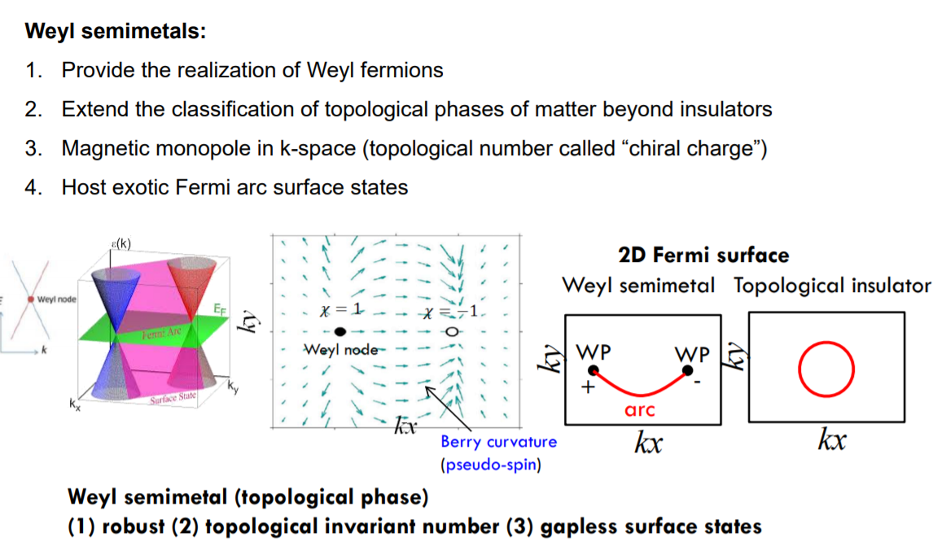
Weyl Semimetals and its properties

Slide 10
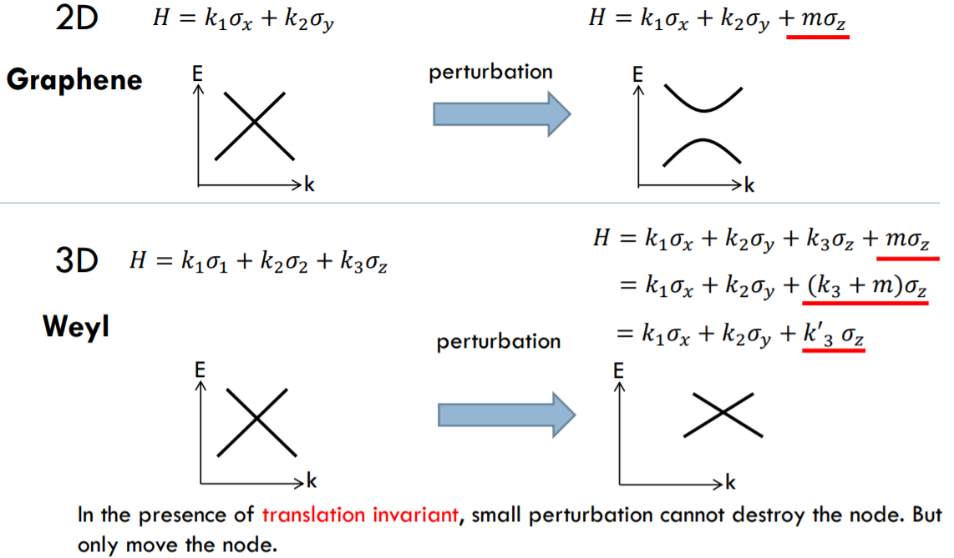
Weyl Semimetals and its properties

Slide 11
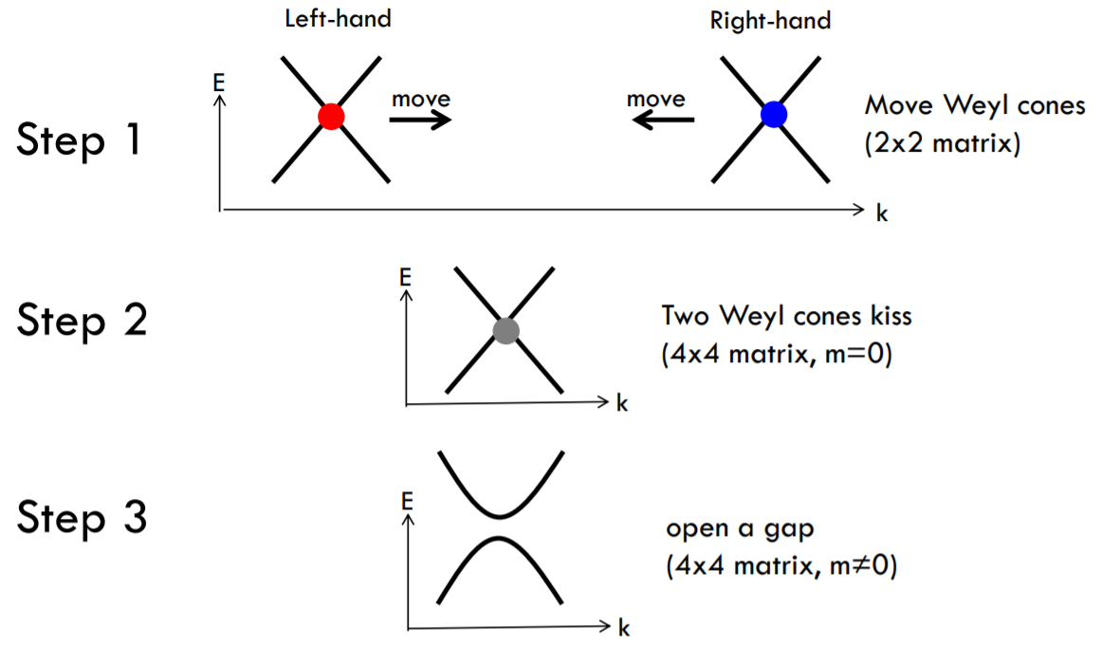
Weyl Semimetals annihilation

Slide 12
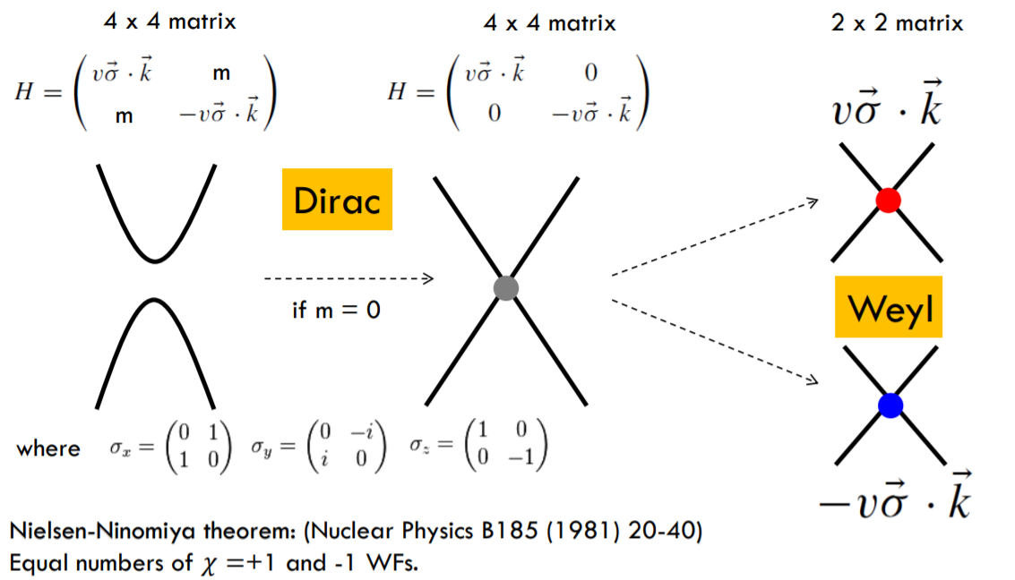
Weyl Semimetals and its properties

Slide 13
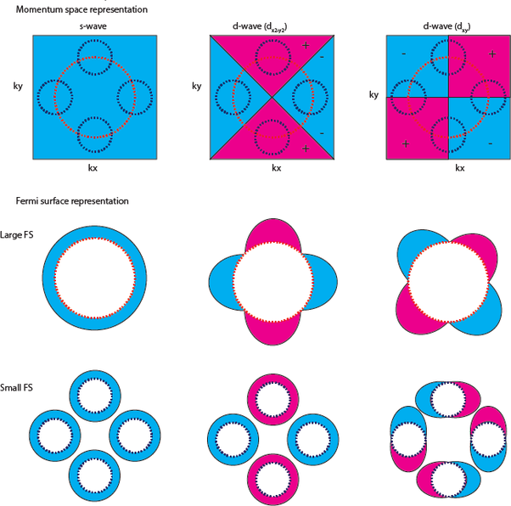
S-wave Superconductors
Notes:
s-wave superconductors have a superconducting gap which is isotropic in all directions, whereas d_{x2−y2} superconductors have a superconducting gap which is anisotropic and is identically zero at four-line nodes located at the diagonals of the Brillouin zone.

Slide 14
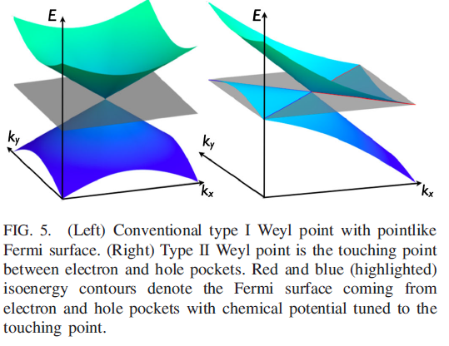
Weyl Semimetals types

Slide 15
Candidacy as a Quantum Computation Device
Could provide a robust weak link to carry supercurrent in Josephson junctions
A recent study on a lateral junction made of Td-WTe2 has shown a nontrivial temperature dependence of critical current Ic(T) in which a short junction behavior was observed in a long junction device
Missing n = 1 Shapiro step indicates the existence of the nontrivial 4π-periodic supercurrent
Integrating 2D materials with superconducting circuits is an emerging topic in searching of new types of quantum computing devices
Recently, a topological insulator nanoribbon has been reported for use in superconducting quantum circuits.
In addition, the S-T-S junction naturally provides a platform to explore the physics associated with Majorana bound states (MBS)
Notes:
2. The long-lived temperature dependence of Ic(T) has been attributed to the topologically protected Fermic arc states in WSMs.
3. was observed in a nanowire JJ made of Dirac semimetal Cd3As2 and is also attributed to its surface Fermi arc states
4. For example, graphene for its superb conductivity and 2D tunable nature
6. S (superconductors) T (topological materials)
short Josephson junction is characterized by the Josephson phase $φ(t)$ which is only a function of time, but not of coordinates the Josephson junction is assumed to be point-like in space
In contrast, in the long Josephson junction the Josephson phase can be a function of one or two spatial coordinates, i.e., $φ(x,t)$ or $φ(x,y,t)$
Shapiro steps are AC JJ behavior

Slide 16
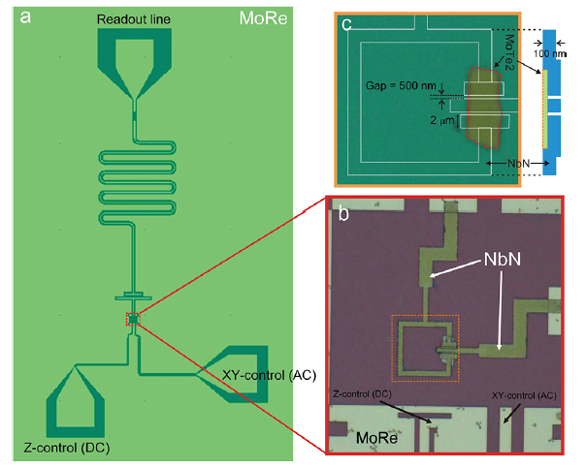
Device Layouts and Measurement Setups
Notes:
a). The MoTe2 SQUID is shunted by the T-shaped island to the surrounding ground plane and coupled to a reflective readout cavity made of MoRe.
The SQUID and shunting capacitor is equipped with a DC line (Z-control) for flux tuning and an AC line (XY-control) for applying additional drive tone
b). Optical micrograph showing the MoTe2 SQUID made of NbN, and the Zcontrol and XY-control lines made of MoRe
c). The geometry of MoTe2 SQUID before the deposition of NbN.
The SQUID is formed by a square loop (line width: 2 μm) with MoTe2 covering two 500 nm gaps.
The right inset shows the cross-section across the gaps.
d) Measurements: sample is mounted in an aluminum box and thermality anchored to a fridge at 10mK.
The readout cavity of device is connected to the input and output of a network analyzer for scattering parameter (S21) measurement
A digital-to-analog converter (DAC) used for applying DC voltage is connected to the Z-control line for magnetic flux tuning
Whereas an RF source used for applying additional tone for two-tone measurements is connected to the XY-control line

Slide 17
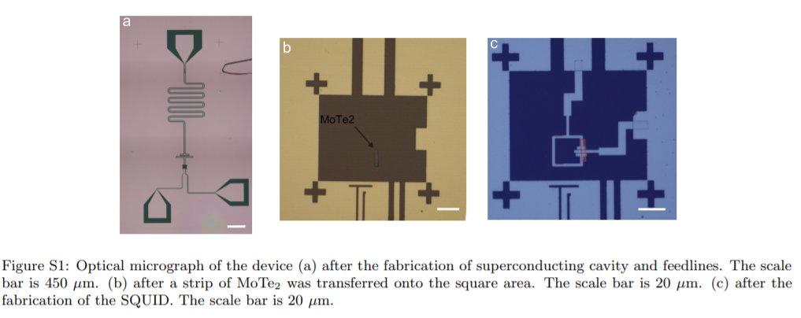
Device Fabrication
Notes:
Sputtering of 80nm MoRe onto intrinsic Si wafers capped with 285 nm SiO2.
2. The structures of cavity and feedlines are defined by a laser writer
ICP etching (Fig a.)
Afterwords, a strip of multilayered MoTe2 was transferred onto the square area (b)
After Electron Beam Lithography (電子束微影) and sputtering of superconducting leads (NbN), the SQUID is fabricated ©

Slide 18
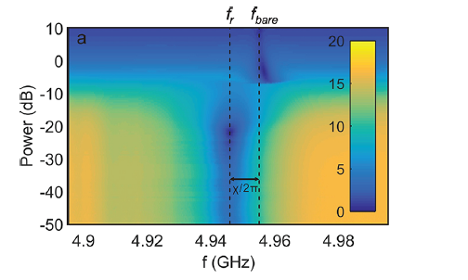
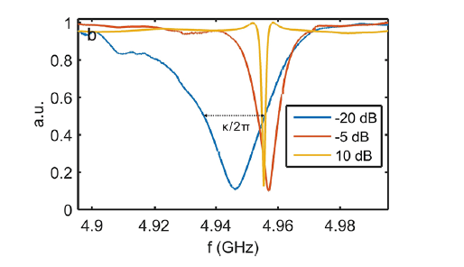
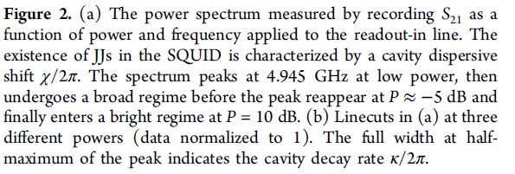
Device Characterization and Results I. Power Dependence Measurement
Notes:
(Fig 2b)The SQUID along with the shunting capacitor is coupled to a λ/2 superconducting reflective cavity with a bare resonant frequency fc ≈ 4.955 GHz
and a loaded quality factor Q ≈ 3964 obtained via fc/Δf from the trace of P = 10 dB
The research team first performed a standard qubit power-dependent experiment in which the S21 is measured as the function of the input power applied to the readout line.
A conventional way to confirm the existence of JJ in transmon, where the resonant frequency of the cavity shifts toward the transmon frequency at large enough power (here at around −5 dB)
Here, we note that we have not demonstrated temporal coherence or energy-level spectroscopy in our device,
which does not justify the device as a transmon.
The power dependent frequency shift is generally attributed to the nonlinearity that cavity inherits from JJs in which cavity can
not be approximated to a perfect harmonic oscillator as the photon occupation number increases

Slide 19
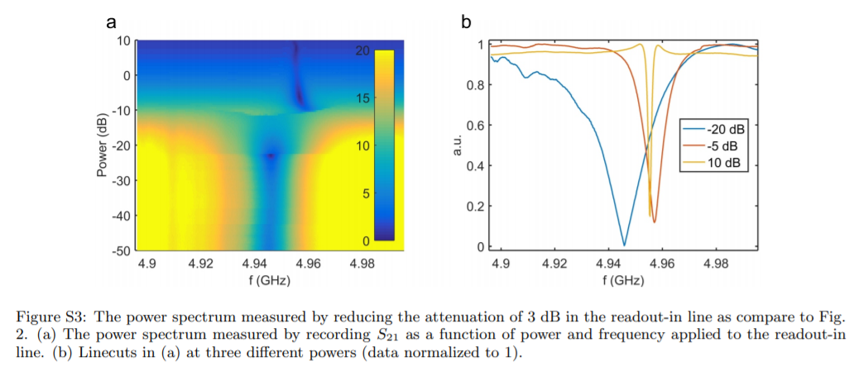

Device Characterization and Results I. Power Dependence Measurement

Slide 20
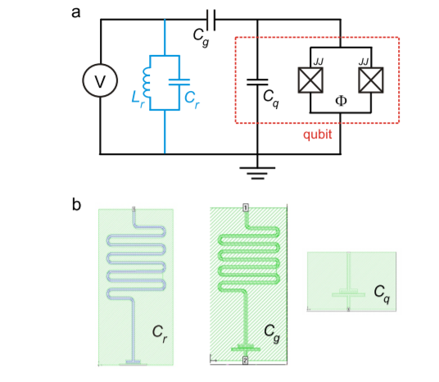


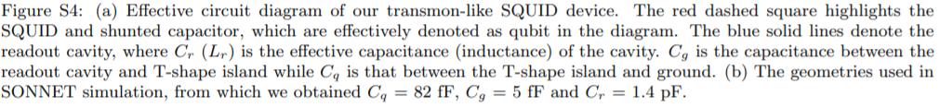
Device Characterization and Results II. Coupling Strength Estimation

Slide 21



Device Characterization and Results II. Transmon frequency estimation
Transmon is working in the dispersive regime
Doesn’t satisfy strong dispersive condition
Knowing $g, χ,Δ, f_{r}$
Notes:
The magnitude of the shift χ/2π, as shown in Figure 2a, allows us to estimate the transmon frequency via χ = g2/Δ
where g is the transmon-cavity coupling strength and Δ/2π = f r − f t is the difference between f r and the transmon frequency f t.
In our system, g/2π is estimated to be 116 MHz from which we can infer f t ≈ 6.29 GHz.
The fact that |g/Δ| ≪ 1 indicates our transmon is working in the dispersive regime.
However, |g2/Δ| is close to the cavity decay rate κ, which does not satisfy the strong dispersive condition of g2/ Δ ≫ κ and may in fact place a limitation for us to perform the state-dependent readout of cavity.

Slide 22
Glossary
Weyl Semimetals
Long/Short JJ
Majorana Bound States
S-wave superconductors
Topological anomalies
Chirality
Gamma Matrices
Dirac/Weyl equation
Zero mode
Fermi Arcs
Type I-II Weyl Semimetal
Shapiro Steps

Slide 23
References
以拓樸概念解開物質的奧祕 陳則銘 | 成功大學物理學系|2017/07/05
https://scitechvista.nat.gov.tw/c/sfTh.htm
拓樸材料於半導體的應用 林育中| 台大物理學系 2019-01-17|
https://www.digitimes.com.tw/col/article.asp?id=996
Topological Materials II (ppt) | 國立清華大學 2012|
http://w3.phys.nthu.edu.tw/~spin/course/106F/Lecture%2012%20Topological%20materials%20-2.pdf
Weyl and Dirac semimetals in three-dimensional solids | N. P. Armitage, E. J. Mele, Ashvin Vishwanath 2018-01-22
Long Josephson Junction |Wikipedia 2016-03-19
https://en.wikipedia.org/wiki/Long_Josephson_junction
Supplementary Information: A flux tunable superconducting quantum circuit based on Weyl semimetal MoTe2 | Kuei-Lin Chiu,. et al | 中山大學 2020

